Slide 1

Team Name : AstroIntellect
Team Leader Name : Tanmayi Sri Gajjarapu
Problem Statement : Developing an Algorithm for Air Quality Visualizer and Forecast App to Generate Granular, Real-time, and Predictive Air Quality Information

Slide 2

Team Members
Team Leader: Name: Tanmayi Sri Gajjarapu College: CVR College of engineering | Team Member-1: Name: Akshaini Sandri College: CVR College of engineering
Team Member-2: Name: Gayathri Vanam College: CVR College of engineering | Team Member-3: Name: Deekshasri Bachu College: CVR College of engineering

Slide 3
Brief about the Idea:
Our idea is to create an inclusive Air Quality Visualizer and Forecast App that helps underserved regions in India access crucial data. Unlike standard AQI apps that focus on metro cities with ground stations, our solution uses satellite data, local weather, and smart algorithms to offer detailed AQI information even for the smallest villages. Users can find updates through pin-code searches, receive voice alerts in local languages, and access SMS for those without smartphones. The app includes offline modes and community display boards, ensuring that people without internet access or smartphones can still benefit. Additionally, the app forecasts air quality for the next 24 to 72 hours, provides health tips, and offers APIs for schools, hospitals, and local organizations to respond during high pollution events..

Slide 4
Opportunity should be able to explain the following:
Different from Existing Solutions
Works for rural areas using satellite and pin-code AQI.
Offers voice and SMS access, not just smartphone apps.
How It Solves the Problem
Brings real-time and predictive AQI to underserved regions.
Provides health alerts, emergency mode and community tools.
USP
An inclusive, hyperlocal AQI platform using satellite data and AI; designed for rural Bharat to protect health and raise awareness.

Slide 5
List of features offered by the solution
📡Satellite and Ground AQI Integration 📍 Pin-Code Based AQI Access 🔮 72-Hour Forecasting with AI 🩺 Health Tips Based on AQI Levels 🗣️ Voice Alerts in Local Languages 📲 SMS-Based AQI for Offline Users 🚨 Emergency Protocol Mode 🏫 School & Hospital Dashboards (via API) 📷 Pollution Reporting via Photos 🔥 Source Mapping: Traffic, Industry, Crop Fires 💡 Designed for accessibility, real-time awareness, and community participation; especially in rural and underserved areas.

Slide 6
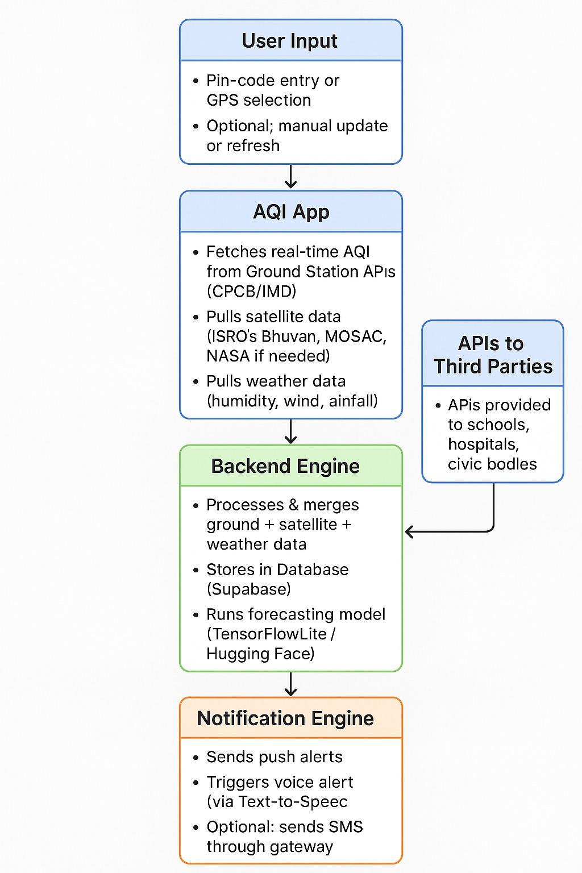
Process flow diagram or Use-case diagram

Slide 7
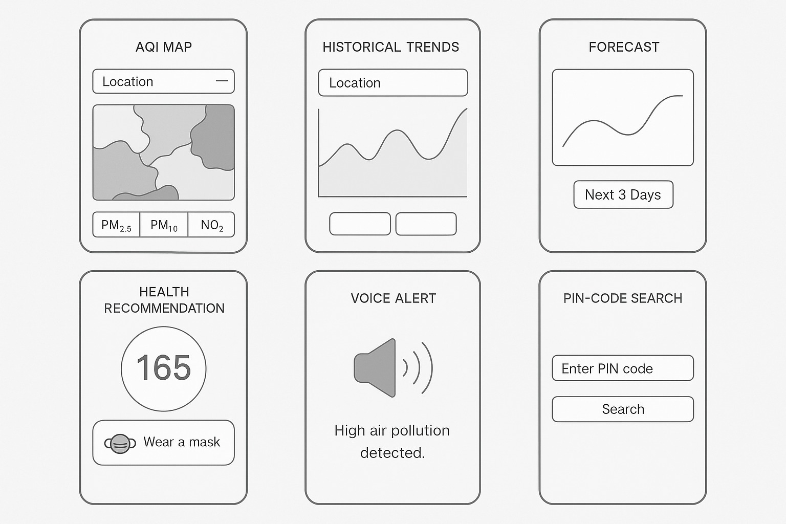
Wireframes/Mock diagrams of the proposed solution

Slide 8
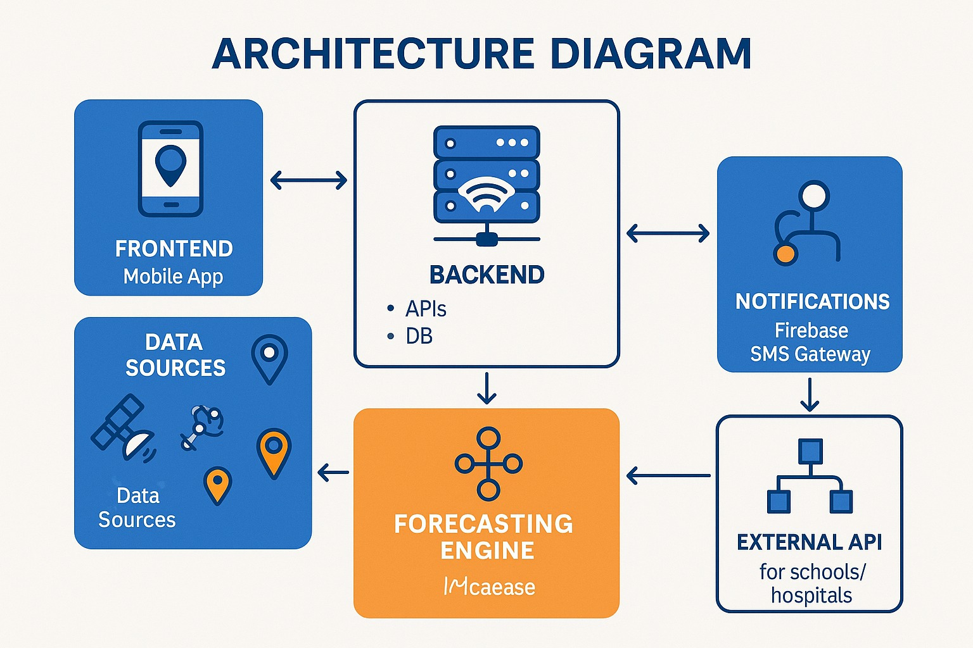
Architecture diagram of the proposed solution

Slide 9
Technologies to be used in the solution:
Layer | Tools & Technologies
💻 Frontend | React.js / Flutter
🔧 Backend | Node.js + Express
🗄️ Database | Supabase / Firebase Realtime DB
🗺️ Maps & APIs | Bhuvan API / Google Maps API
📈 Forecasting | TensorFlow Lite / Hugging Face API
🔔 Alerts | Firebase Cloud Messaging / Twilio / SMS Gateway
📊 Analytics | Google Analytics / Firebase Analytics
🧪 Testing | Jest / Postman

Slide 10
Estimated implementation cost:
Implementation Cost (MVP Level)
Development & Tools
React.js, Flutter, Node.js, Firebase → ₹0 (Free & Open Source)
Hosting & Database
Firebase Hosting, Supabase DB → ₹0 (within free tier)
APIs & Maps
Google Maps API (under free limit) → ₹0
Bhuvan API (Govt-supported) → ₹0
AI Forecasting
TensorFlowLite (free)
Hugging Face API (optional) → ₹750/month (if used)
Alerts & SMS
Firebase Push Notifications → ₹0
Twilio or SMS Gateway → ~₹0.40/SMS
(Example: 500 SMS/month → ₹200)
Total Estimated Monthly Cost: ₹950 to ₹1,250

Slide 11
✅ Impact & Reach
Our solution has the potential to reach *millions of people* in India’s villages, semi-urban towns, and underserved areas. By delivering hyperlocal air quality data even where ground stations are missing, we help people make safer daily choices. Schools, hospitals, and Panchayats can act faster with clear, real-time alerts and health recommendations. Display boards, offline access, and voice or SMS tools ensure that even people without smartphones or stable internet benefit.
✅ Conclusion
By combining satellite data, smart forecasting, pin-code search, and easy community access, we bridge the urban–rural gap for air quality information. Our goal is to empower every citizen with the knowledge to protect their health and surroundings. With ISRO’s support, we can turn this vision into reality and make clean air data truly universal for India’s future.

Slide 12


